Slide 1
Divide and Conquer Approach Dr. Tathagata Ray Assistant Professor, BITS Pilani, Hyderabad Campus rayt@hyderabad.bits-pilani.ac.in

Slide 2
Substituition Method
The substitution method is used for solving recurrences.
Two step process
Step 1: Guess the form of the solution
Step 2: Use mathematical induction to find the constants and show that the solution works.

Slide 3
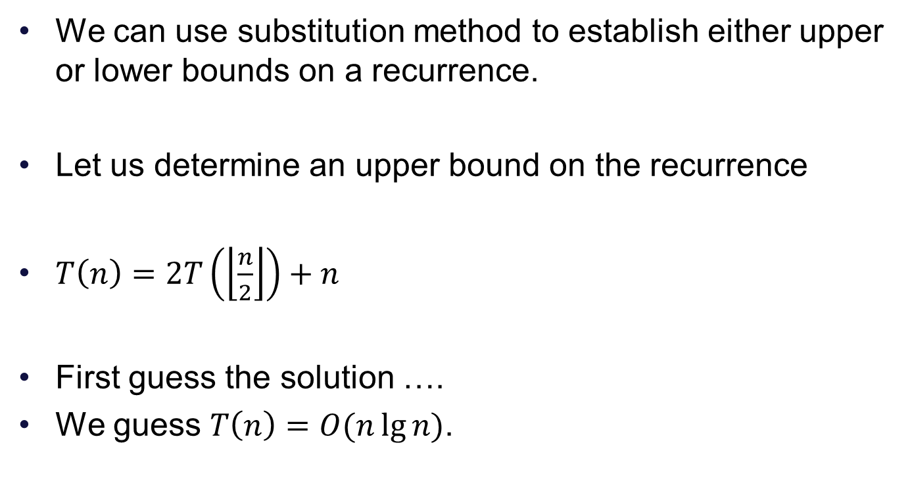
Example
We can use substitution method to establish either upper or lower bounds on a recurrence.
Let us determine an upper bound on the recurrence
$T\left(n\right)=2T\left(\left\lfloor \frac{n}{2}\right\rfloor \right)+n$
First guess the solution ….
We guess $T\left(n\right)=O(n\lg{n)}$.

Slide 4
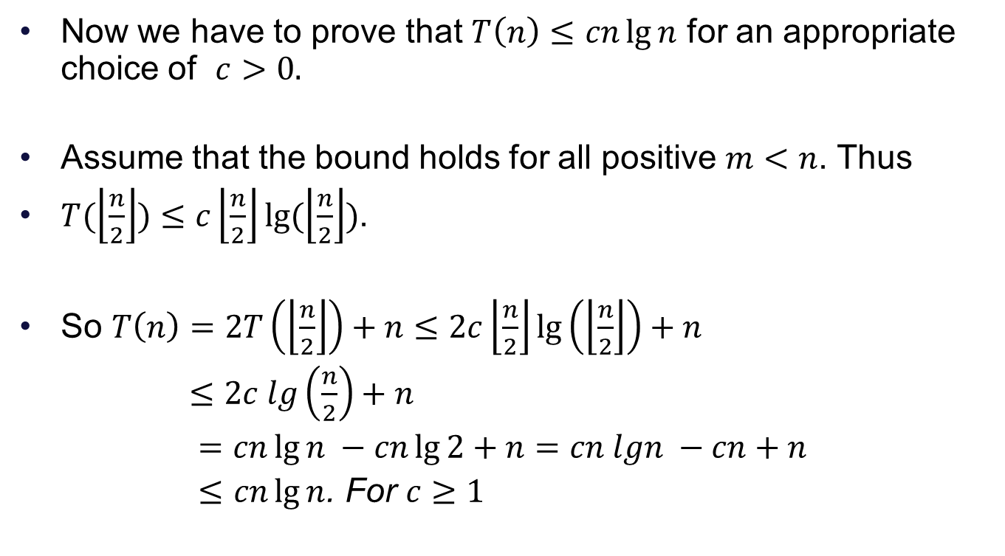
Next step
Now we have to prove that $T\left(n\right)≤cn\lg{n}$ for an appropriate choice of $c>0.$
Assume that the bound holds for all positive $m<n$. Thus
$T(\left\lfloor \frac{n}{2}\right\rfloor )≤c\left\lfloor \frac{n}{2}\right\rfloor lg⁡(\left\lfloor \frac{n}{2}\right\rfloor )$.
So $T\left(n\right)=2T\left(\left\lfloor \frac{n}{2}\right\rfloor \right)+n≤2c\left\lfloor \frac{n}{2}\right\rfloor \lg\left(\left\lfloor \frac{n}{2}\right\rfloor \right)+n$
$≤2c lg\left(\frac{n}{2}\right)+n$
$=cn\lg{n} −cn\lg{2}+n=cn lgn −cn+n$
$≤cn\lg{n}$. For $c≥1$

Slide 5
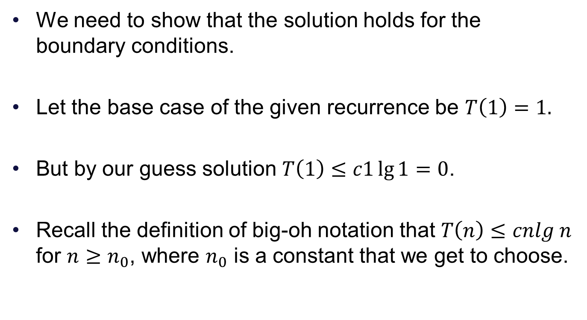
Next step
We need to show that the solution holds for the boundary conditions.
Let the base case of the given recurrence be $T\left(1\right)=1.$
But by our guess solution $T\left(1\right)≤c1\lg{1}=0$.
Recall the definition of big-oh notation that $T\left(n\right)≤cnlg n$ for $n≥n_{0}$, where $n_{0}$ is a constant that we get to choose.

Slide 6
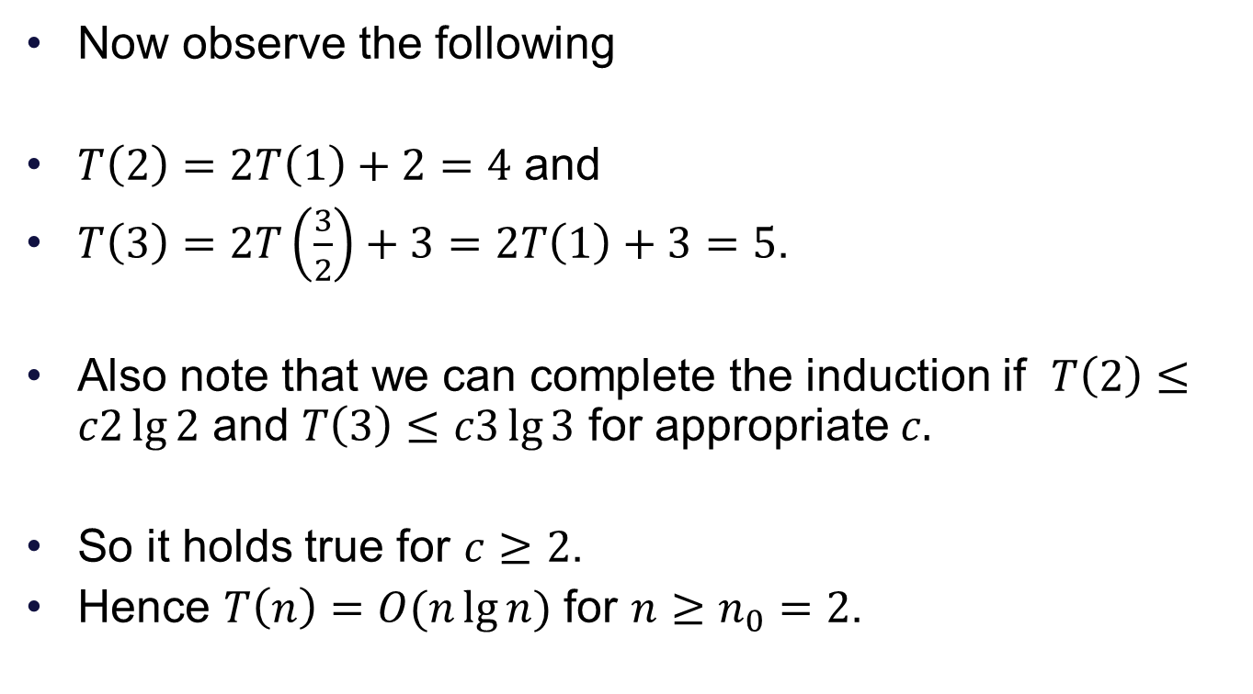
Completing the induction
Now observe the following
$T\left(2\right)=2T\left(1\right)+2=4$ and
$T\left(3\right)=2T\left(\frac{3}{2}\right)+3=2T\left(1\right)+3=5$.
Also note that we can complete the induction if $T\left(2\right)≤c2\lg{2}$ and $T\left(3\right)≤c3\lg{3}$ for appropriate $c.$
So it holds true for $c≥2$.
Hence $T\left(n\right)=O(n\lg{n})$ for $n≥n_{0}=2$.

Slide 7
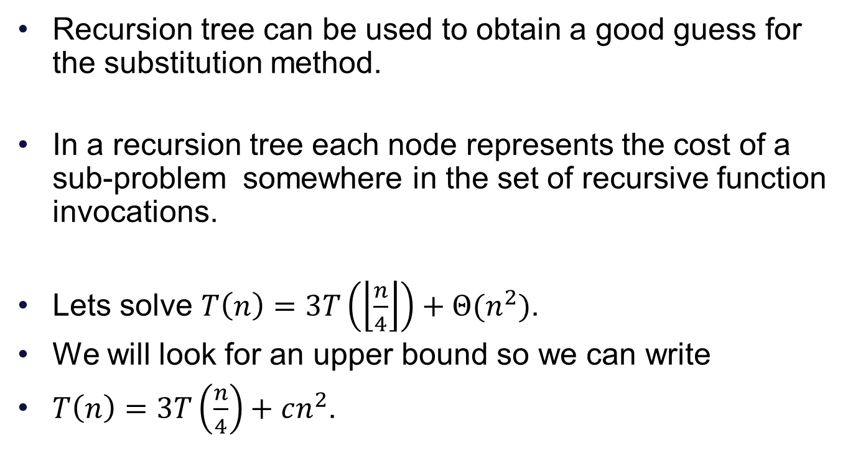
Recursion Tree Method
Recursion tree can be used to obtain a good guess for the substitution method.
In a recursion tree each node represents the cost of a sub-problem somewhere in the set of recursive function invocations.
Lets solve $T\left(n\right)=3T\left(\left\lfloor \frac{n}{4}\right\rfloor \right)+Θ{(n}^{2})$.
We will look for an upper bound so we can write
$T\left(n\right)=3T\left(\frac{n}{4}\right)+cn^{2}$.

Slide 8
Recursion Tree

Slide 9
Recursion Tree

Slide 10
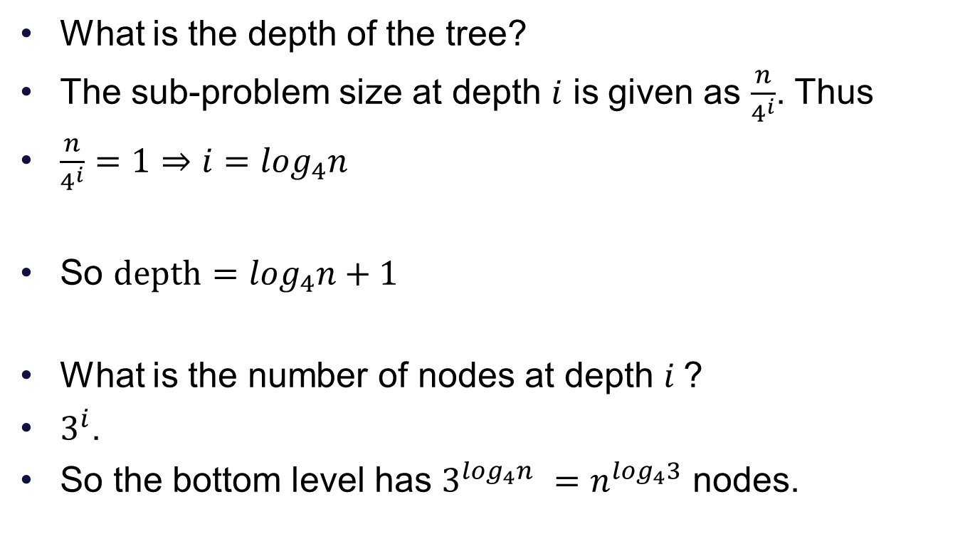
Recursion Tree
What is the depth of the tree?
The sub-problem size at depth $i$ is given as $\frac{n}{4^{i}}$. Thus
$\frac{n}{4^{i}}=1⇒i=\log_{4}n$
So $depth=\log_{4}n+1$
What is the number of nodes at depth $i$?
$3^{i}$.
So the bottom level has $3^{\log_{4}n }=n^{\log_{4}3}$ nodes.

Slide 11
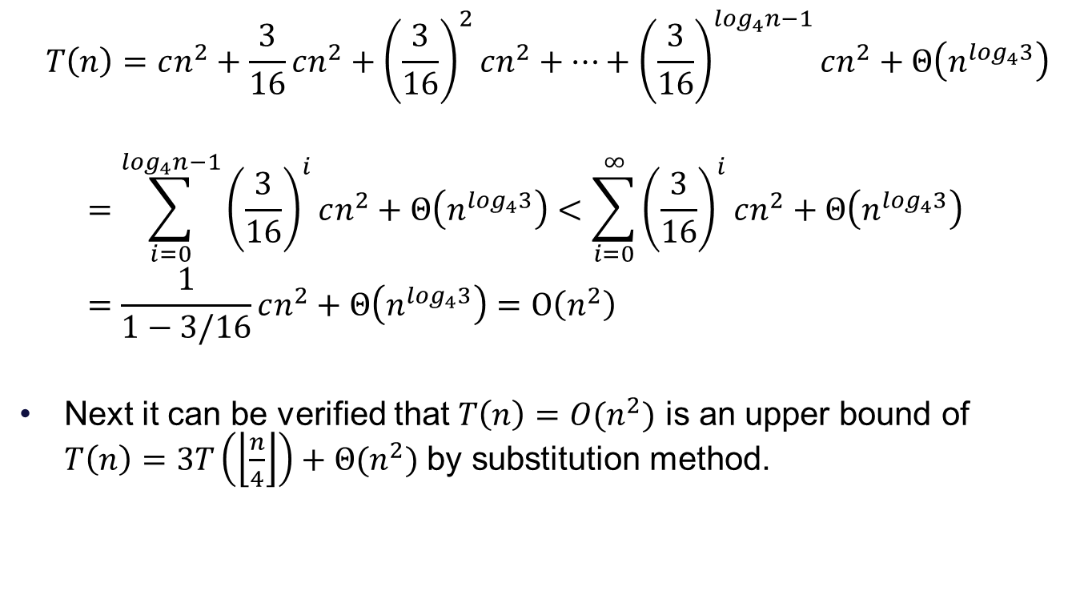
Total running time
$$T\left(n\right)=cn^{2}+\frac{3}{16}cn^{2}+{\left(\frac{3}{16}\right)}^{2}cn^{2}+…+{\left(\frac{3}{16}\right)}^{\log_{4}n−1}cn^{2}+Θ\left(n^{\log_{4}3}\right)$$
$$=\sum_{i=0}^{\log_{4}n−1}{{\left(\frac{3}{16}\right)}^{i}cn^{2}}+Θ\left(n^{\log_{4}3}\right)<\sum_{i=0}^{∞}{{\left(\frac{3}{16}\right)}^{i}cn^{2}}+Θ\left(n^{\log_{4}3}\right)=\frac{1}{1−3/16}cn^{2}+Θ\left(n^{\log_{4}3}\right)=O\left(n^{2}\right)$$
Next it can be verified that $T\left(n\right)=O(n^{2})$ is an upper bound of $T\left(n\right)=3T\left(\left\lfloor \frac{n}{4}\right\rfloor \right)+Θ{(n}^{2})$ by substitution method.

Slide 12

Substitution method
$$T\left(n\right)≤3T\left(\left\lfloor \frac{n}{4}\right\rfloor \right)+cn^{2}$$
$$≤3d{\left\lfloor \frac{n}{4}\right\rfloor }^{2}+cn^{2}$$
$$≤3d{\left(\frac{n}{4}\right)}^{2}+cn^{2}$$
$$=\frac{3}{16}dn^{2}+cn^{2}$$
$$≤dn^{2}$$
For $d≥\left(\frac{16}{13}\right)c$.

